Slide 1


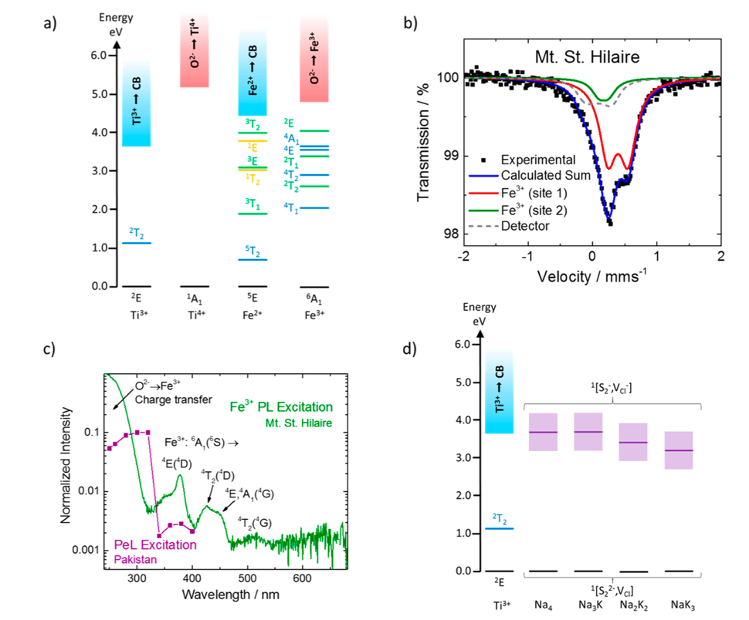
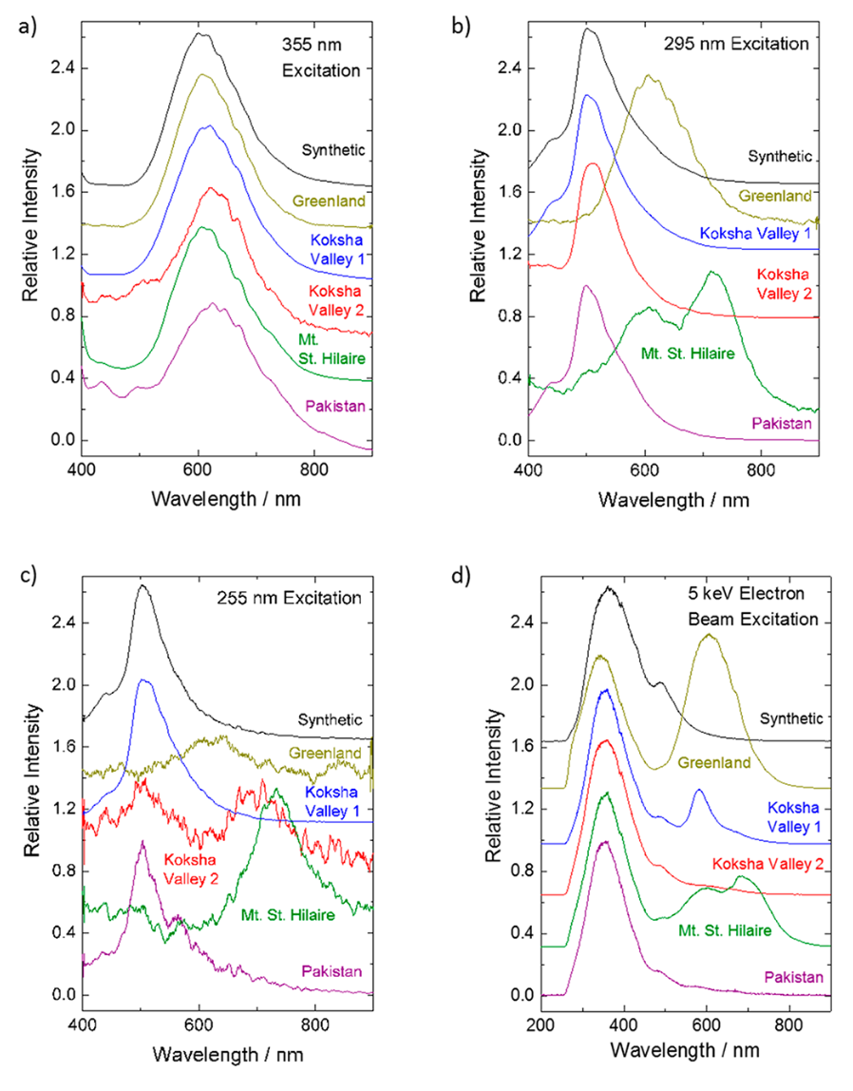
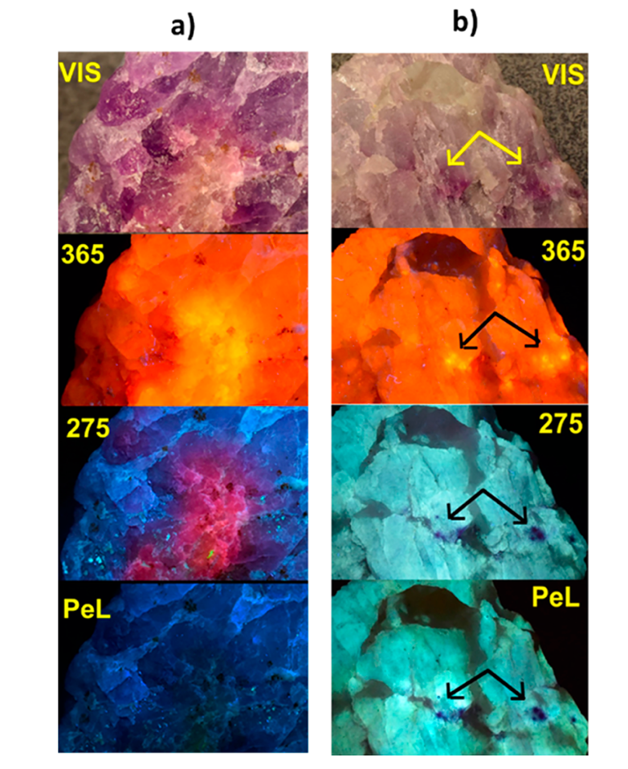
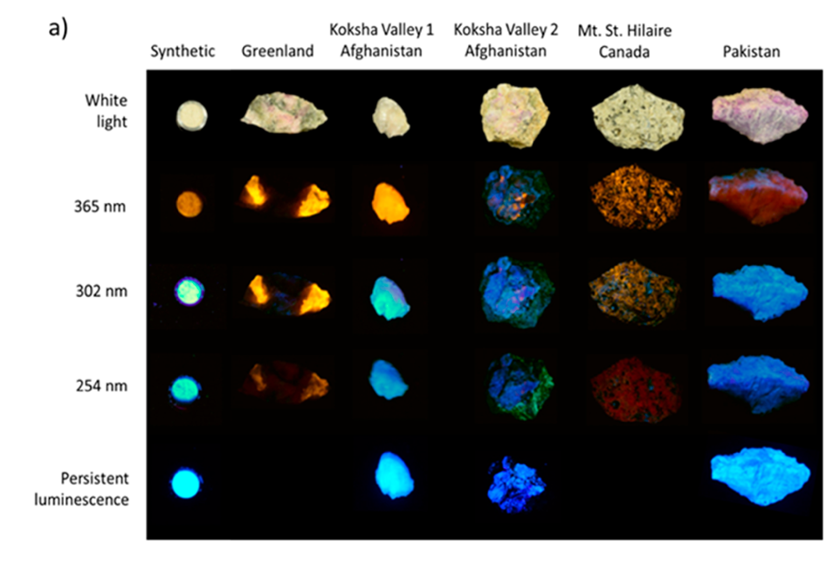
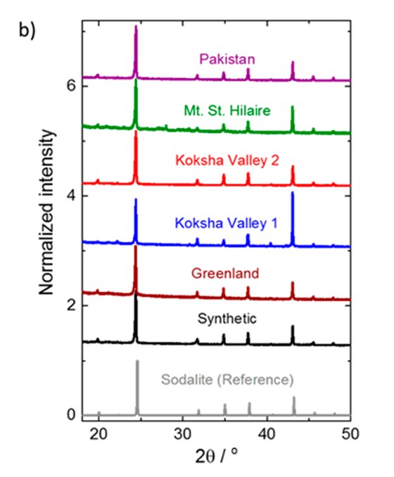
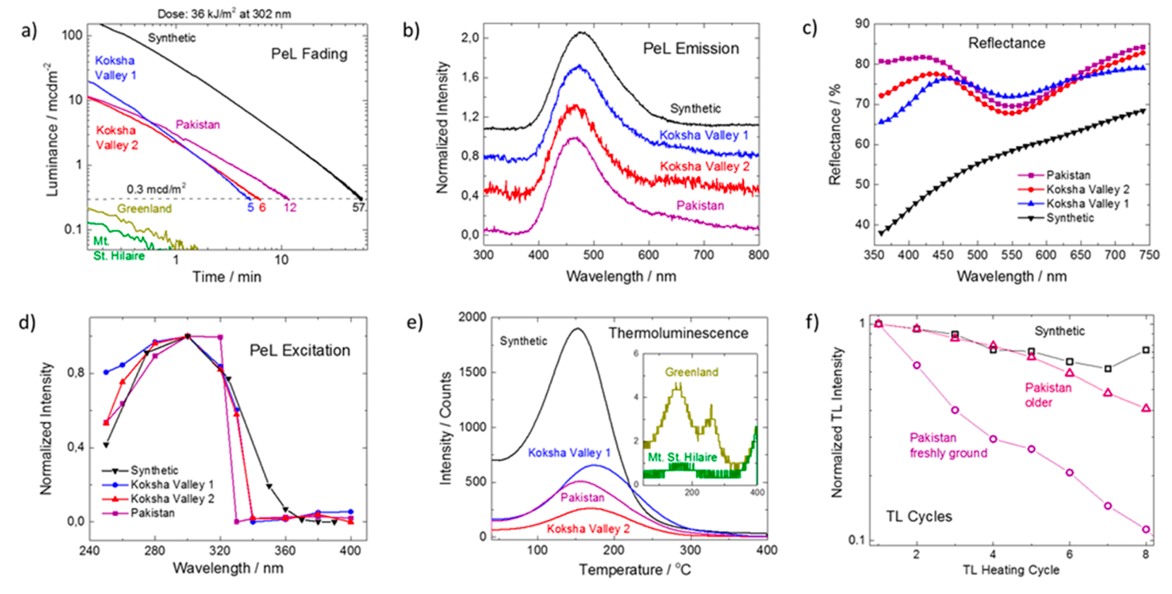
Hackmanite: The Natural Glow-in-the-Dark Material
Author: WANG Jing LIU Ziqi
ABSTRACT
MATRIEALS AND METHODS
"Glow-in-the-dark" materials, familiar to most travelers via airplanes or cruise ships, are frequently utilized for self-lit emergency exit signs, featuring a green afterglow known as persistent luminescence (PeL).
MATRIEALS
Resources: Private collectors
Crystal structure: X-ray powder diffraction measurements
Elemental composition: Bruker Tornado M4 micro- XRF spectrometer/ PANalytical Epsilon1 device
Photoluminescence: UV lamps UVP UVLS-24 with 4W at 254/365 nm / UVP UVM-57 with 6W at 302 nm
Persistent luminescence: Hagner ERP-105 luminance photometer
Photon counting experiments: determine the storage capacity
Elemental distributions: SEM-EDX point analyses
Interplay between Titanium and Iron.
Figure 3. (a) Quantum chemically calculated energy states of Fe3+, Fe2+, and Ti3+ in the Al3+ site as well as Ti4+ in the Si4+ site.
(b) 57Fe Mössbauer spectrum of the Mt. St. Hilaire sample.
(c) Photoluminescence excitation spectrum of the red Fe3+ band for the Mt. St. Hilaire sample and PeL excitation spectrum of the Pakistan sample
(d) Quantum chemically calculated energy states of Ti3+ (in the Al3+ site)
Divalent europium doped synthetic strontium aluminate, commonly referred to as hackmanite, presents an intriguing avenue for exploration, as its afterglow remains largely unexamined. Despite this, synthetic versions show promise in rivalling some of the leading commercially available persistent luminescence (PeL) materials. The findings from these investigations not only illuminate the PeL phenomenon but also offer valuable insights for enhancing the performance of synthetic materials.
METHODS
Energy levels: Combining DFT periodic boundary condition calculations.
Geometry optimizations: the CRYSTAL17 code, global hybrid functional PBE0
Mössbauer spectra: Doppler velocity of ∼2.0 mm/s and calibrated with α-Fe.
Nonlinear least-squares fitting program: the quadrupole coupling constant, the relative component intensities, and the isomer shift δ relative to α-Fe.
(4a) An electron's excitation from Ti3+ to the conduction band occurs at approximately 3.7 eV (335 nm), consistent with the PeL excitation threshold energy.
(4b) Mössbauer measurements for the Mt. St. Hilaire sample, which exhibits the highest Fe content and shortest PeL duration.
(4c) The photoluminescence excitation spectrum of Fe3+ in hackmanite.
INTRODUCTION
RESULTS AND DISCUSSION
Hackmanite, a mineral typically found in nepheline syenites, phonolites, and similar rock formations, as well as in metasomatized calcareous rocks and cavities of volcanic blocks, is renowned for its distinctive property of displaying purple tenebrescence. This phenomenon, characterized by reversible photochromism, occurs upon exposure to UV and X-rays.
Initial Characterization
Figure 2. Photoluminescence spectra upon continuous LED excitation at (a) 355, (b) 295, and (c) 255 nm (d) cathodoluminescence spectra.
(a) Excitation at 355 nm: All samples exhibit the characteristic orange emission of S2− entities.
(b) Excitation at 295 nm: Most samples display a blue/green emission peaking at approximately 500 nm.
(c) Excitation at 255 nm: With this wavelength, all samples except Greenland and Mt. St. Hilaire exhibit the blue/green emission band.
For Greenland samples, the emission is attributed to disulfide, while for Mt. St. Hilaire samples, a peak at 720 nm is observed.
(d) Cathodoluminescence spectra: This combines all signals, showcasing a strong UV/blue band peaking at 350 nm for natural samples and at 364 nm for the synthetic sample.
Interplay between Potassium and Sulfur
(6d) The tenebrescence process efficiently decreases PeL.
The presence of sulfur correlates with a weakening of PeL.
Incorporation of potassium into the structure results in a reduction in overlap as the potassium concentration increases.
Persistent Luminescence and Energy Storage Properties
Investigate the factors influencing the manifestation of persistent luminescence in natural hackmanites presenting a quantitative analysis of their PeL and optical energy storage characteristics.
Our study examines five natural hackmanite samples sourced from different locations: Greenland, Mont Saint Hilaire (Canada)
Koksha Valley (Afghanistan) - represented by two separate samples, and Pakistan.
The research explores the relationships between the composition, concentration of various impurities, and the observed PeL phenomenon.
Figure 3. (a) PeL fading curves
(b) PeL emission spectra
(c) Reflectance spectra before any UV exposure or heating
(d) PeL excitation spectra
(e) Thermoluminescence glow curves of the natural and synthetic samples.
(f) Effect of repeated charging/heating cycles on the TL signal of the synthetic and Pakistan samples.
REFERENCE
[1].Agamah, C., Vuori, S., Colinet, P., Norrbo, I., Miranda de Carvalho, J., Nakamura, L. K. O., Lindblom, J., van Goethem, L., Emmermann, A., Saarinen, T., Laihinen, T., Laakkonen, E., Lindeń, J., Konu, J., Vrielinck, H., Vander Heggen, D., Smet, P. F., Le Bahers, T., & Lastusaari, M. (2020). Hackmanite—The natural glow-in-the-dark material. Chemistry of Materials, 32(20), 8895–8905. https://dx.doi.org/10.1021/acs.chemmater.0c02554

